Slide 1
Sutures
© Partnership for Environmental Education and Rural Health at
College of Veterinary Medicine & Biomedical Sciences, Texas A&M University
Funding support from the National Institutes of Health Office of Research Infrastructure Programs (ORIP)
Notes:
This presentation has been adapted from notes by Rance Redhouse, Lane Atene, Kyle John and Craig Kohn

Slide 2
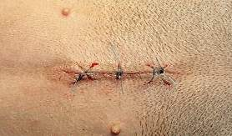
What is a suture?
A stitch or row of stiches
holding together the edges
of a wound or surgical incision.

Slide 3
TYPES OF SUTURES
Continuous
Interrupted
Purse String

Slide 4
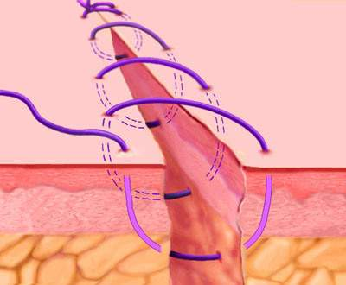
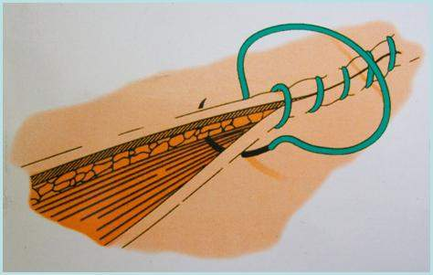
Continuous Sutures
A continuous suture made from
an uninterrupted series of stitches.
Also known as uninterrupted sutures or Running Stitches.

Slide 5
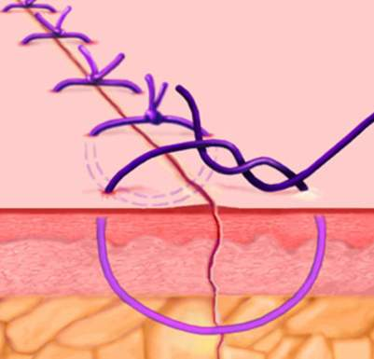
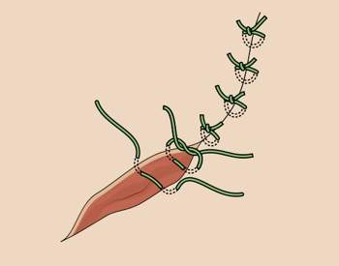
Interrupted Sutures
An interrupted or non-continuous suture made where each stitch is tied separately.

Slide 6
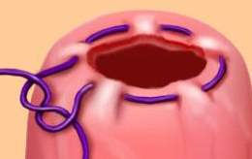
Purse String Sutures
A continuous stitch that closes the edges of a circular wound.
Commonly used to close circular wounds, such as a hernia or
on the heart.
Notes:
Video demonstrations of purse string suture practices:
http://www.youtube.com/watch?v=nVyiDKfgr48
http://www.youtube.com/watch?v=mvFfm0Msbwo

Slide 7
Let’s Compare the Types of Sutures
Continuous
+ Faster; Takes less time
+ Less Expensive
+ Less foreign material in wound
- Less control over tension
- If knot failure, big deal
Interrupted
+ More control over tension
+ If one knot failure, not a big deal
- Slower; More time needed
- More Expensive
- Increased amount of foreign material in wound

Slide 8
TYPES OF SUTURE Materials
Non-Absorbable
Absorbable

Slide 9
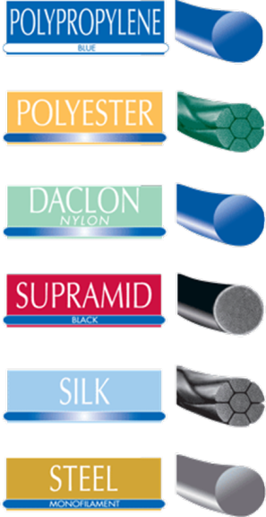
Non-Absorbable
Made of materials that are not
readily broken down by the
body’s enzymes or by hydrolysis.
Non-absorbable materials can
be removed or left in place
permanently.
Notes:
Hydrolysis= breakdown due to water; dissolvable in water

Slide 10
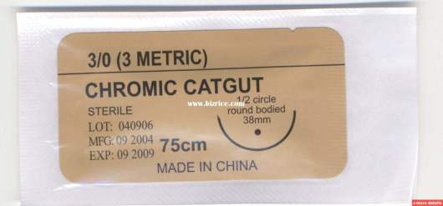
Absorbable
Made of materials that can be broken down by the enzymes and water in the patient’s body.
Less of a likelihood of an immune reaction.
The original absorbable material was chromic catgut (still used today). This is made from animal intestines and
breaks down after 7 days.

Slide 11
Tools used to make SUTURES
Curved Needle
Needle Holder
Suture Material
Forceps
Skin Hook

Slide 12
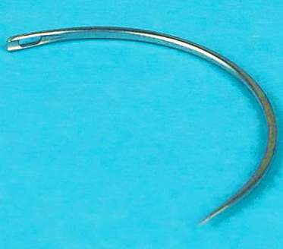
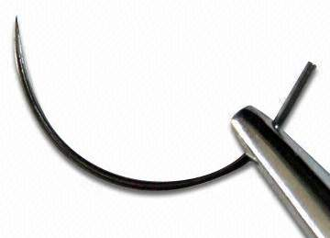
Curved Needle
Curved needles work best when suturing.
This type of needle is shaped like an arc to easily slide under and back up through the tissue.
Can be used for any type of suture.

Slide 13
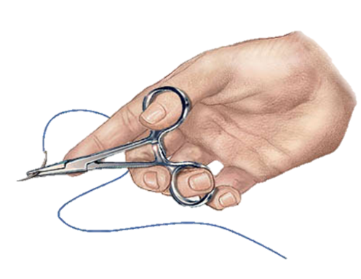
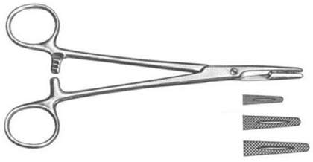
Needle Holder
Locking needle forceps, or Needle Holders are used to hold and guide a suture needle.
This surgical tool has a serrated part, to hold the needle, and a cutting portion, for cutting the suture material.

Slide 14
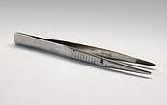
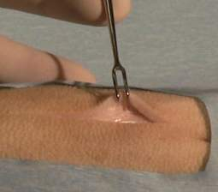
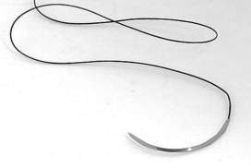
Forceps, Skin Hook, Suture Material
Forceps
  Used to hold tissue, to control the
  position of the skin to make it easier
  to pass the needle and suture material.
Skin Hook
  Used to lift the tissue, to control the
  position of the skin when suturing.
  Doesn’t clamp skin as forceps do.
Suture Material
  Material used to close a wound and
  hold body tissues together.

Slide 15
Tying suture knots

Slide 16
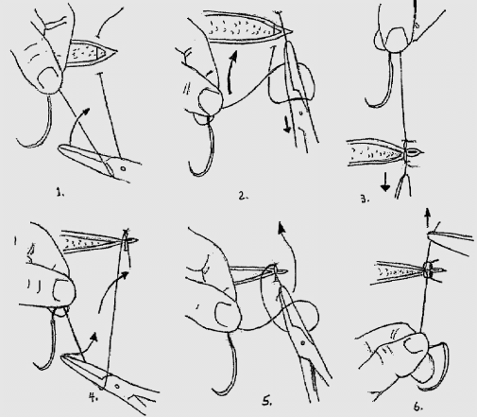
Tying a Square Suture Knot
Wrap suture material OVER needle holders 2X
Grab tail with needle holders
Pull to tighten knot
Wrap suture
material UNDER 2X
Grab tail
Pull to tighten knot

Slide 17
Removal of sutures

Slide 18
Removal of Sutures
WHERE are the Sutures | WHEN to Remove
Face | 3-4 days
Head | 5 days
Torso | 7 days
Legs | 7-10 days
Feet | 10- 14 days

Slide 19
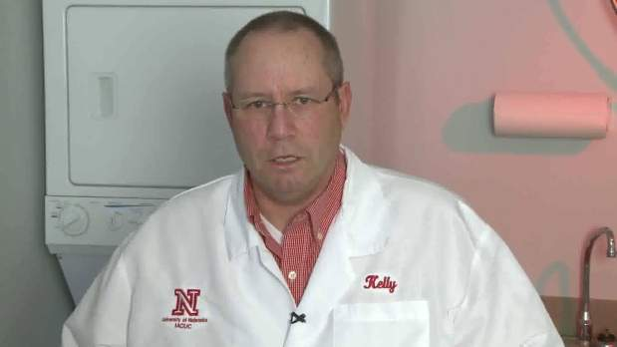
How to Remove Sutures
Cleanse the skin around the suture.
Gently elevate the suture and snip the suture with scissors.
Remove the suture by gently pulling with the forceps.

Slide 20
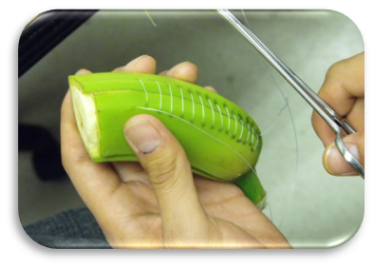
Let’s Practice suturing!

Slide 21
What Will You Need?
1 half Banana (the greener, the better)
1 Curved Needle (or a sewing needle)
Needle Holders (or needle nose pliers)
Suture Material (or dental floss)
Surgical Scissors (or classroom scissors)
Forceps

Slide 22
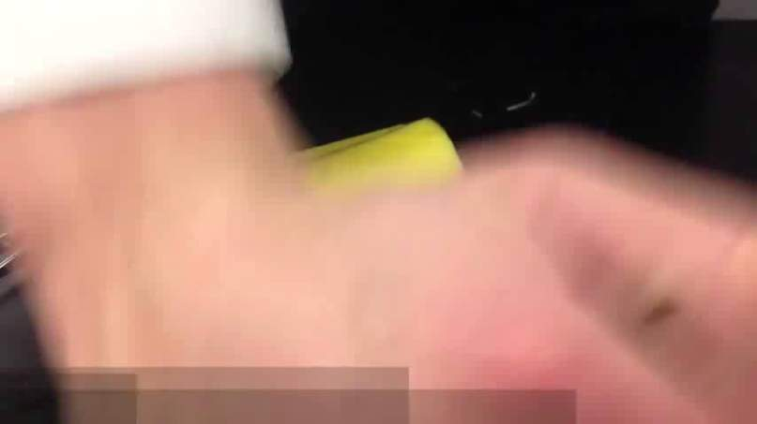
Preparing Your Suture Needle
Thread your needle with suture material.
Tie a square knot, as shown by your teacher.
Notes:
You can find this full video at: http://www.youtube.com/watch?v=_PH-Hzz6ixY

Slide 23
Practicing Interrupted Sutures
Use your forceps to lift the skin enough to begin your suture.
Beginning from the outside of the banana, insert the needle through the skin but not into the below tissues.
Pull the needle out from under the skin through the incision site.
Starting again from the inside of the banana, at the incision site, insert the needle through the skin.
Pull the needle up, closing the incision gently.
Tie a square knot and trim the suture material ends.

Slide 24
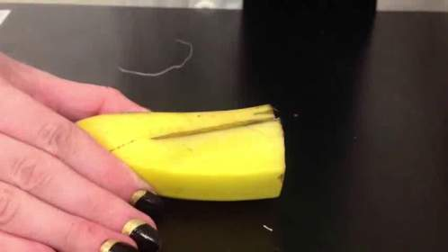
Practicing Interrupted Sutures
Click the picture to watch the video.
Begin playing at 1:28
Notes:
Full video can be found at: http://www.youtube.com/watch?v=_PH-Hzz6ixY Begin playing video at 1:28

Slide 25
Practicing Continuous Sutures
Use your forceps to lift the skin enough to begin your suture.
Beginning from the outside of the banana, insert the needle through the skin but not into the below tissues.
Pull the needle out from under the skin through the incision site.
Starting again from the inside of the banana, at the incision site, insert the needle through the skin.
Pull the needle up, closing the incision gently.
Tie a square knot do not trim ends yet.
Repeat steps 1-5 until entire incision site is closed.
Tie end off with a square knot and trim suture material.
Notes:
Steps 1 – 5 are same as Interrupted Sutures.

Slide 26
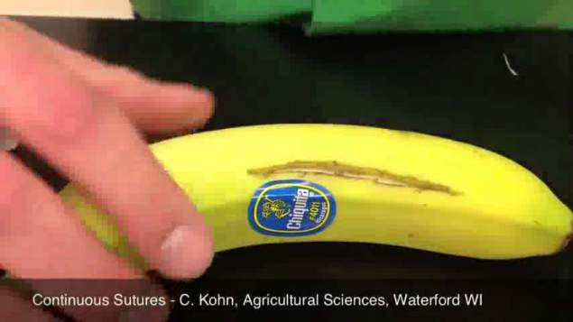
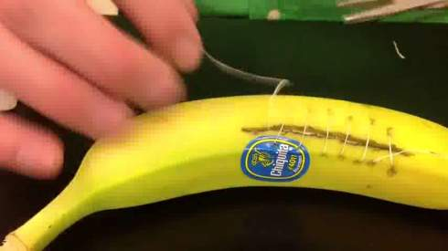
Practicing Continuous Sutures
1.
2.
Notes:
You can find this full video at: http://www.youtube.com/watch?v=LFzkH6U_M5c

Slide 27
© Partnership for Environmental Education and Rural Health at
College of Veterinary Medicine & Biomedical Sciences, Texas A&M University
Funding support from the National Institutes of Health Office of Research Infrastructure Programs (ORIP)

